Slide 1
AGM
May 10, 2023

Slide 2
Forward-Looking Statements
Some matters discussed in this presentation may be considered to be forward- looking statements. Such statements include declarations regarding management’s intent, belief or current expectations. Prospective investors are cautioned that any such forward-looking statements are not guarantees of future performance and involve a number of risks and uncertainties. Actual results could differ materially from those indicated by such forward-looking statements. Such risks and uncertainties include: the Corporation will continue to conduct its operations in a manner consistent with past operations; the general continuance of current industry conditions and the accuracy of the Corporation’s market outlook expectations for 2023 and in the future; the expectation that the Corporation will be able to expand its motor rentals and sales and that revenue will continue to grow in in future periods and that this will also enhance profitability, that future business, regulatory and industry conditions will be within the parameters expected by the Corporation, anticipated financial performance, business prospects, impact of competition, strategies, the general stability of the economic and political environment in which the Corporation operates; the impact of pandemics and the Russian-Ukrainian war on the global economy, specifically trade, manufacturing, supply chain, inflation and energy consumption, among other things and the resulting impact on the Corporation’s operations and future results which remain uncertain, the anticipated impact of global supply chain disruptions and inflation on the Corporation’s operations, results, and the Corporation’s planned responses thereto, exchange and interest rates including the potential for further interest rate hikes by global central banks and the impact on financing charges and foreign exchange and the anticipated global economic response to concerted interest rate hikes; the Corporation’s intent to preserve balance sheet strength and continue to reward shareholders, including through the ROCS Program; the continuance of existing (and in certain circumstances, the implementation of proposed) tax, royalty and regulatory regimes; the sufficiency of budgeted capital expenditures in carrying out planned activities; the availability and cost of labour and services and the adequacy of cash flow; debt and ability to obtain financing on acceptable terms to fund its planned expenditures, which are subject to change based on commodity prices; market conditions and future oil and natural gas prices; and potential timing delays. Although Management considers these material factors, expectations, and assumptions to be reasonable based on information currently available to it, no assurance can be given that they will prove to be correct.

Slide 3
PHX Energy Services - Fun Facts
Founded PHX in 1995
PHX is 28 years in the business
PHX is the largest independent supplier of directional drilling services in the North American land market
PHX works for 12 of the top 15 energy producers in North America
In the first quarter, PHX was drilling 100 horizontal wells in North America per day
PHX provides the technology that allows faster drilling
PHX has 870 full-time employees
Employs 19 electrical, mechanical and software engineers
Recently drilled 17,000 feet in 7.5 days in the Permian basin
PHX drilled 40 million feet of hole in 2022 in the North America
76% of revenue is in the US
85% of that revenue is in the Permian
PHX completed an aggressive $73.5 million capital program in 2022
PHX will allocate $61.5 million to expand in 2023
Our fleet of premium technology operates at maximum capacity with high demand for this equipment
PHX will be able to increase our job capacity by another 25-30 active jobs per day compared to activity in 2022
PHX used NCIB and bought back 17% of outstanding shares from 2017-2021
PHX pays a dividend of .60 per share annually, or $30 million per year
PHX recently announced ROCS program that targets 70% of Excess Cash Flow to be returned to shareholders

Slide 4
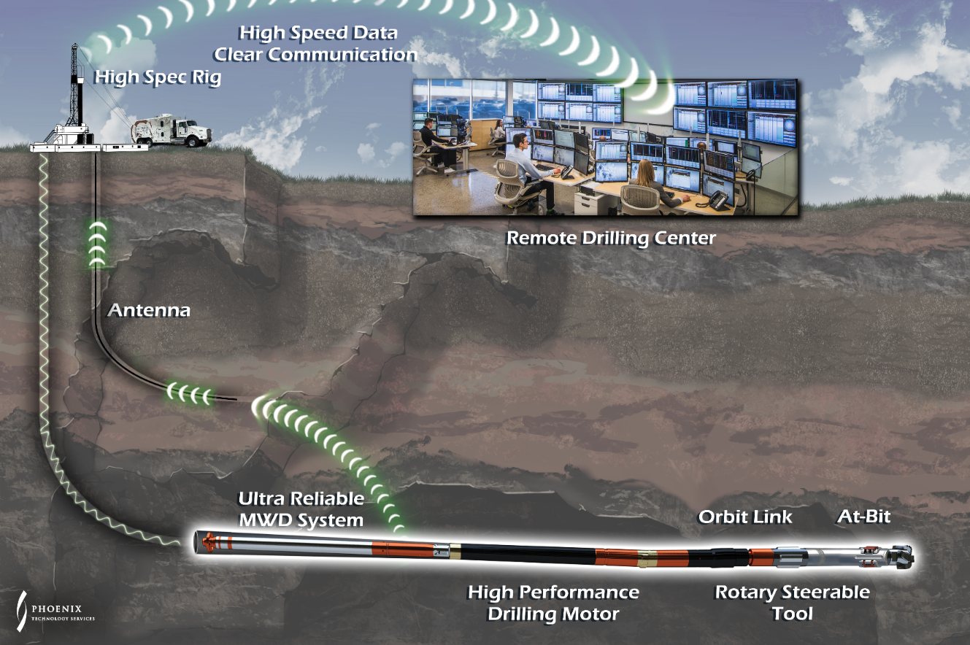
Who Is PHX ?
We are a vertically integrated supplier and control the full value chain of our products and services through in-house R&D, engineering, manufacturing field operations and servicing of our tools
We are a technology leader in our sector and have developed and deployed a proprietary fleet of premium down hole technology in a sustainable manner
We remain focused on being the best pure play directional provider while exploring options to diversify our operations into new markets where we can leverage our technology and expertise
$190mm
9 month -
Consolidated Revenue
Directional drilling is the process of steering the well path towards an intended target and doing so in a manner that increases the overall efficiency and speed of the operation

Slide 5
Q1 2023 Financial Results
 | Three-month period ended March 31, |  |  | Years ended Dec 31,
Stated in thousands of dollars rig counts and operating days | 2023 | 2022 | % Chg | 2022 | 2021 | % Chg
Operating Results
Revenue | 166,022 | 109,304 | 52 | 535,745 | 339,946 | 58
Adjusted EBITDA ⁽¹⁾ | 37,000 | 6,444 | 474 | 92,719 | 60,164 | 54
Adjusted EBITDA ⁽¹⁾ excluding cash-settled share-based | 38,374 | 18,181 | 111 | 117,287 | 73,053 | 61
Excess Cash Flow ⁽¹⁾ | 19,232 | (11,394) | n.m | 21,113 | 22,850 | (8)
Dividend Paid Per Share | 0.15 | 0.05 | 200 | 0.300 | 0.125 | 140
Industry Activity
Canadian Rig Count | 221 | 198 | 12 | 175 | 131 | 34
US Rig Count | 760 | 633 | 20 | 723 | 478 | 51
Operating Day
Canadian Operating Days | 3,051 | 2,730 | 12 | 9,823 | 7,269 | 35
US Operating Days | 4,820 | 4,046 | 19 | 18,248 | 14,041 | 30
Highest level of quarterly revenue, adjusted EBITDA and earnings on record
US division generated all-time quarterly revenue record
(excluding the impact of foreign exchange)
Maintained a strong financial position
⁽¹⁾ See Non-GAAP Measures section of quarterly report
$.15
$14
$106
17%
Dividend Per Share
As at March 31, 2023
Net Debt (in millions) As at March 31, 20223
Working Capital (in millions) As at March 31, 2023
of Shares as at 12-31-2017 Re-Purchased/Cancelled

Slide 6
Net Capital Expenditures ⁽¹⁾
Net Capital Expenditures $46.1 million
Net Capital Expenditures $19.2 million
Net Capital Expenditures $22.9 million
$73.5 million in capital expenditures in 2022
Additional $11.5 million was outstanding at year end and carried over to 2023
Delivery expected in the first half of the year
Net Capital Expenditures $18.5 million
⁽¹⁾ See Non-GAAP and Other Financial Measures section of most recently filed annual/quarterly report

Slide 7
Capital Expenditures
2023 Capital Expenditure Budget of $61.5 million
Stated in thousands of dollars Three-month periods ended March 31, 2023
Growth capital expenditures | 9,955
Maintenance capital expenditures from asset retirements | 4,857
Maintenance capital expenditures from downhole equipment losses | 3,771
 | 18,583
Deduct:
Proceeds on disposition of drilling equipment | (12,417)
Net capital expenditures⁽¹⁾ | 6,166
Expect $41.8 million towards growth capital and $19.7 million towards maintenance of the existing fleet and replacement of equipment lost downhole during drilling operations.
Maintenance capital could increase throughout the year if there are more downhole equipment losses than forecasted, and these increases would likely be funded by proceeds on disposition of drilling equipment.
Our premium technology fleet is currently running at capacity as our technology and services are in high demand.
⁽¹⁾ See Non-GAAP and Other Financial Measures section of most recently filed annual/quarterly report

Slide 8
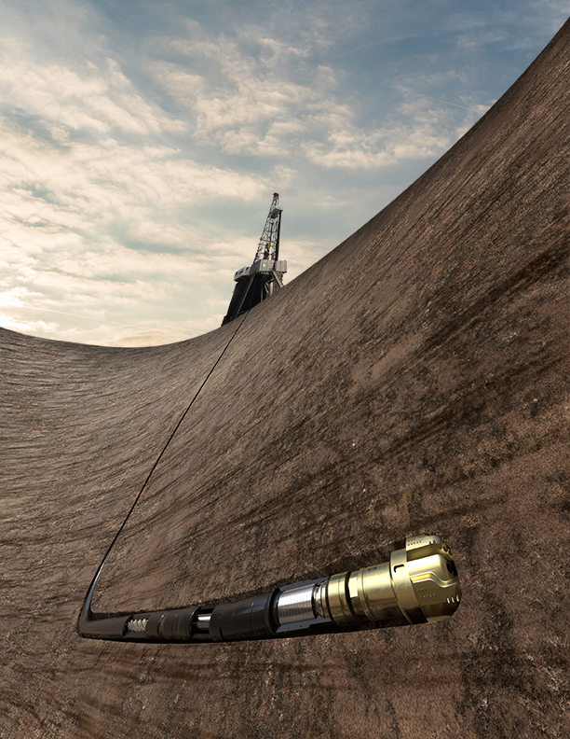
First Quarter Outlook
North American rig count in the first quarter was relatively flat compared to fourth quarter of 2022
Our US activity is seeing a similar slowdown whereas Canada is experiencing a more active spring break up then in the past
Expect slightly lower than forecasted activity levels to persist for a few months as the rig count stabilizes
Despite the slowdown, our Atlas motors remain in high demand and with new opportunities to market these motors, they make up a large portion of the capital expenditures budget
We have recently entered into an Atlas sales agreement with a client and are actively trying to expand this portion of our business and customer base.
Atlas sales division will allow us to further penetrate the North American market, and possibly other international markets.
Complementary to our full service directional offering and opens a portion of the market that may not be accessible on a full-service basis.
Anticipate the additional revenue and associated margins will bolster our already strong financial position.

Slide 9
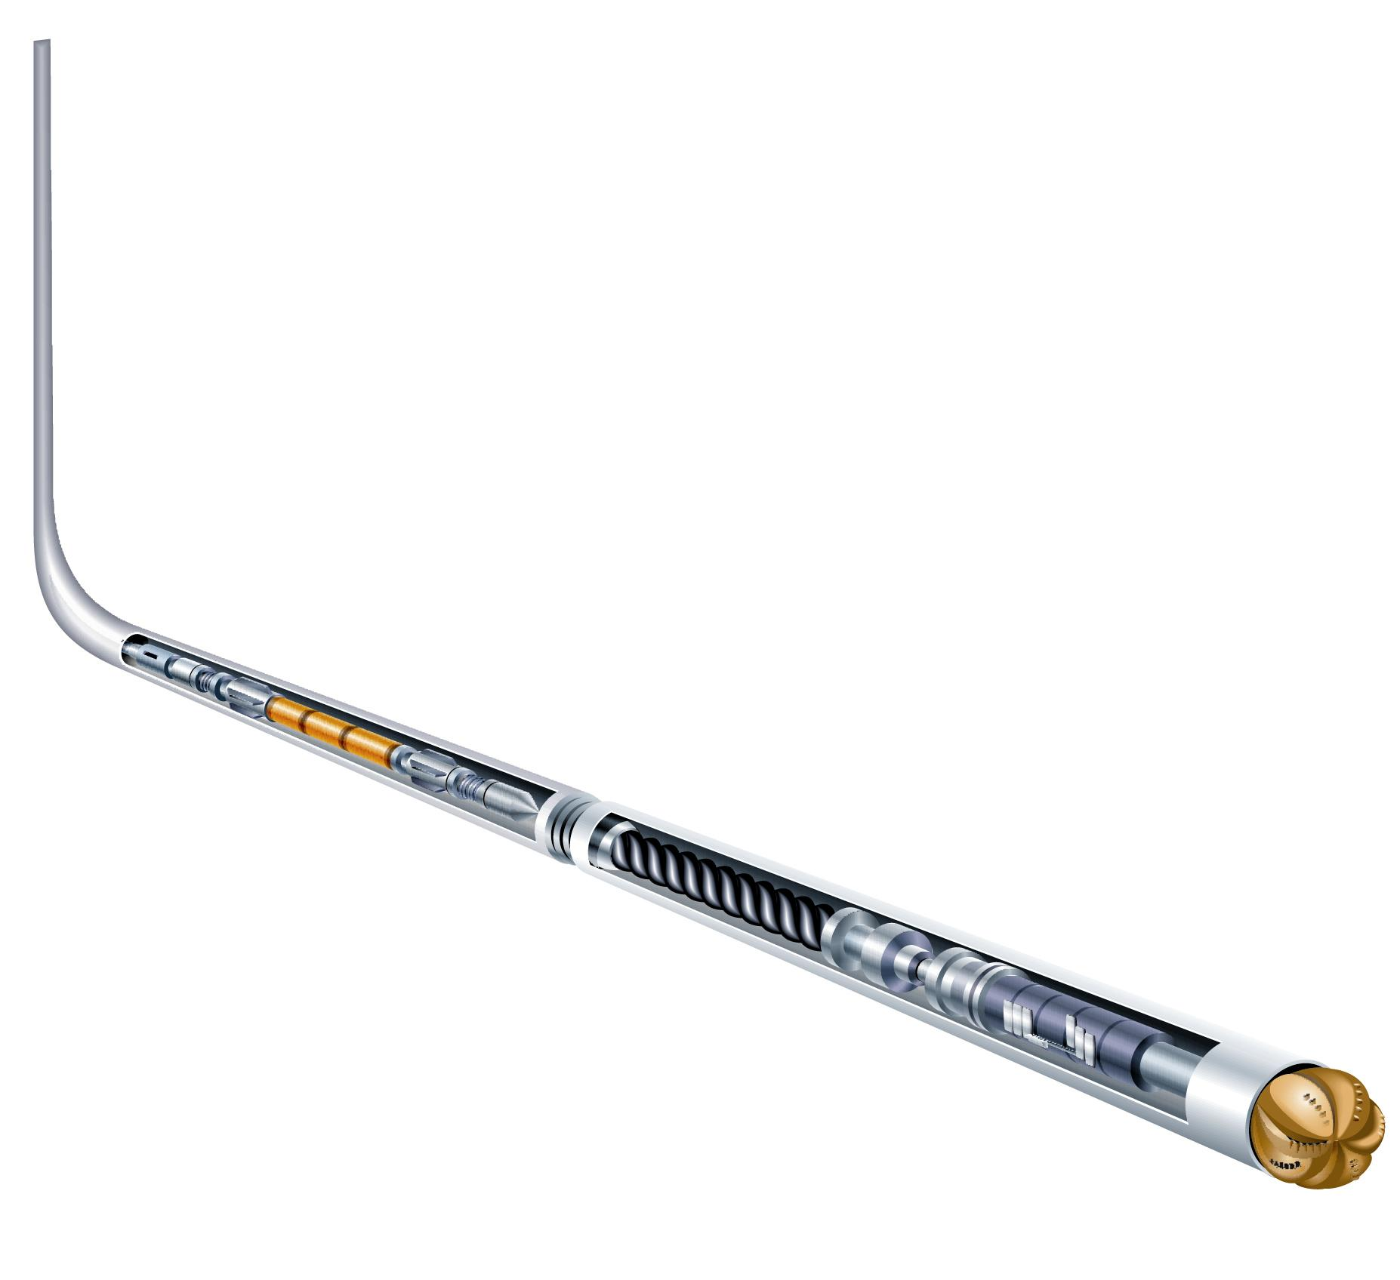
Recent History of Drilling Efficiencies
Drilling Technology - 10 Yrs Ago
Current PHX Drilling Technology
Conventional 6.5“ Drilling Motor
Max Torque 10,460 lb-ft
Horsepower Output 310 HP
Atlas 7.25" High Performance Motor Max Torque 19,050 lb-ft
Horsepower Output 664HP
114% Increase
Game Changer
The Real Driver of Record Fast Drilling Atlas Motors

Slide 10
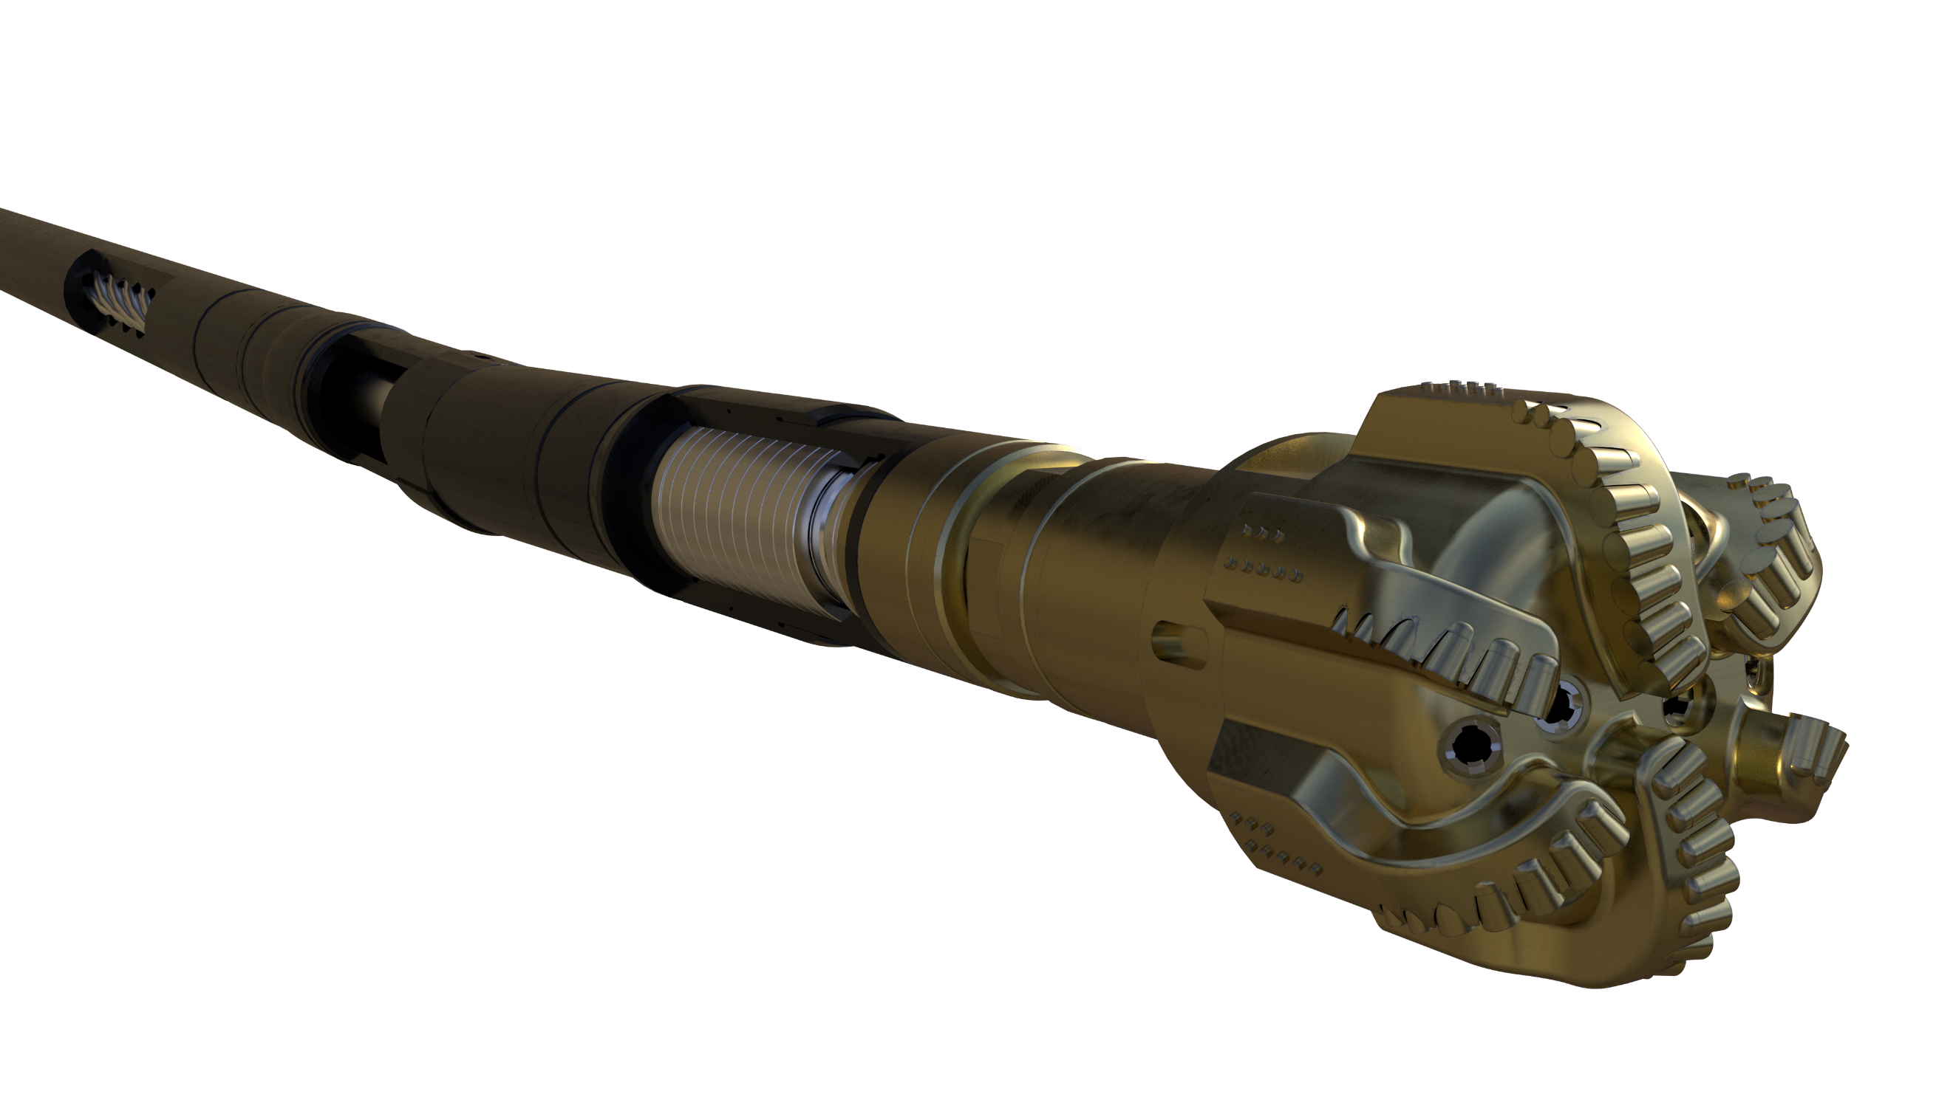
It’s the Name of the Game
Technology Case Study: The Impact of Faster Drilling
Same Area - Same Well Profile - New Technology
2017 - Permian Basin, Midland County
10,000ft Lateral
Conventional technology
Drilling Days 8.76
2021 - Permian Basin, Midland County
11,282ft Lateral
Premium MWD and Motors technology (Atlas and Velocity)
Drilling Days - 3.80
5 Days Saved
230% improvement
Time is Money! PHX Makes this Happen

Slide 11
2022 Results for Shareholder Return
Strong profitability and cash positive position
= Opportunity
17% of Shares repurchased since March 2017
= Opportunity
Reinstated quarterly dividend and increased four times
From 58,589,887 to 51,072,237 Common Shares Outstanding
SHAREHOLDER REWARD
Our strategy to reward shareholders has progressed over a 5-year period and adhering to it has proven paramount
NCIB Purchases
192,000 Shares Cancelled
NCIB Purchases
4,762,300 Shares Cancelled
NCIB Purchases
1,960,788 Shares Cancelled
Dividend Increase
$0.15 per share*
Dividend Re-Instated
$0.025 per share*
Dividend Increase
$0.075 per share*
Zero Debt
Cash Positive
Strategy Part II
Trust Established
Annoucned ROCS:
Payout 70% of
Excess Cash Flow
2017
2018
2019
2020
2021
2022
Dividend Increase
$0.05 per share*
Dividend Increase
$0.10 per share*
NCIB Purchases
482,500 Shares Cancelled
NCIB Purchases
2,670,500 Shares Cancelled
* per quarter dividend per share

Slide 12
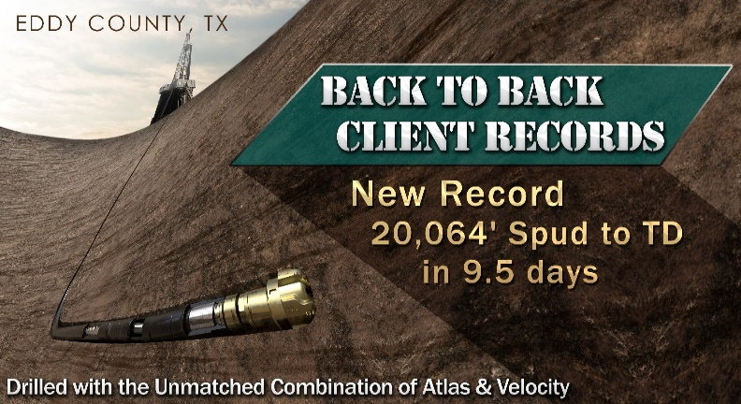
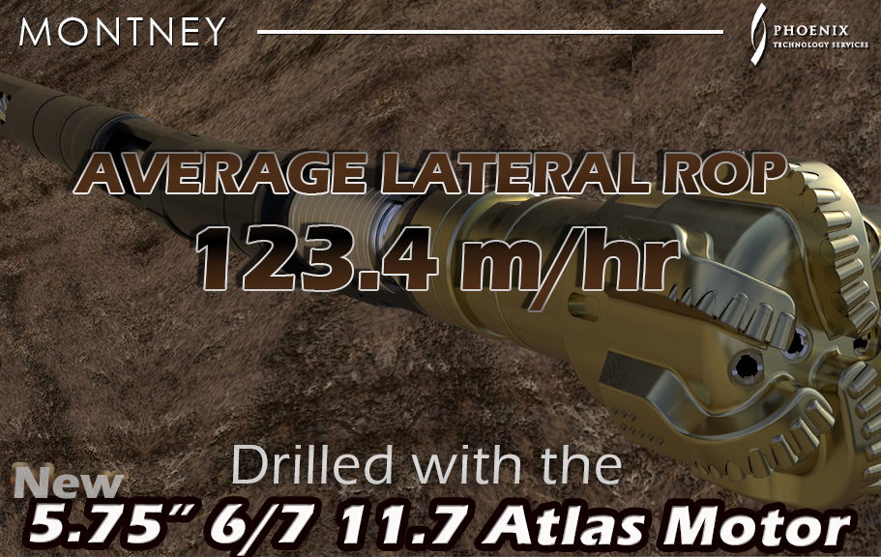
Record After Record

Slide 13
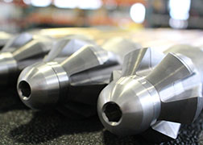
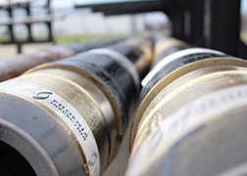
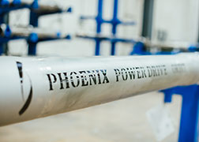
PHX is the Enabler
Premium Technology Fleet is comprised of the industry’s top technologies, cannot be outperformed
Designed, developed, manufactured, and Operated by Phx
Velocity Real-Time System New generation MWD system, with improved reliability, unified telemetry, faster data rates, and advanced measurements
Atlas Performance Drilling Motors Engineered to be the most powerful motor and deliver unmatched performance on high specification drilling rigs
PowerDrive Orbit RSS The industry’s leading RSS technology, with ability to steer the well without pausing the drill string rotation for faster drilling
112
720
51
Velocity MWD Kits
2018 67 Kits
77 Kits
95 Kits
2022 112 Kts
Atlas Drilling Motors
2018 178 Atlas
2020 396 Atlas
2021 456 Atlas
2022 647 Atlas
Rotary Steerable Systems
2018 6 RSS
2020 18 RSS
2021 33 RSS
2022 51 RSS
2023 Capital Expenditure Budget of $61.5 million dedicated to expanding these fleets

Slide 14
PHX Has 28 Yrs. History
28 years
26 years
25 years
12 years
24 years
Total Executive Tenure – 115 Yrs
14% Executive Ownership

